Slide 1
Hooked: Tracking Linker and PAM Persistence on Linux
Jason Trapp
Bsides Canberra 2026

Slide 2
About me
I’m Jason Trapp
Assistant Manager at McGrathNicol
Worked in Digital Forensics and Incident Response for the last 6 years

Slide 3
What we typically hunt
Cron modifications
rc.local / init.d scripts
Systemd unit additions
SSH authorized_keys changes
Notes:
Pretty much every organization has a detection mechanism for at least one of these items. The cron watch, new service unit, the authorized_keys alert. These are great detections to have however, there are more ways for a threat actor to establish persistence

Slide 4
What we MIss
The problem isn’t attacker sophistication. It’s a telemetry gap.
Commonly missed items include:
  PAM configuration
  Dynamic linker (LD_PRELOAD)
  Systemd generators
  Container runtime hooks
APT41 and Aquatic Panda have both exploited LD_PRELOAD for persistence
The tool Ebury can be used to deactivate PAM modules to tamper with the SSHD configuration.
Notes:
The OS gives persistence a dozen other methods to exploit that most logging pipelines won’t touch. PAM and linker preloading files have been around for decades. The gap is that we keep adding detections for the most common methods whilst these side door methods stay unmonitored. Today we will dive into two of these which are PAM configuration and dynamic linkers. With each of these, we will look at how they work, how they’re exploited, watch it happen, and what to log and hunt to catch it.

Slide 5
LAB Setup
OS: Ubuntu 26.04 LTS
Two VMs – one for initiating SSH and the other is the target
Busybox
Notes:
Just a note on the setup, I used Ubuntu 26.04 LTS on two VMs. It’s important to note that Red Hat system paths differ with a note on my GitHub repo. The key point is that this is a stock install, no special configuration, and stock is exactly what is wrong.

Slide 6
PAM mECHANICS
What calls PAM?
  sshd
  sudo
  login
  su
  cron
  cups
How PAM resolves it?
  Configuration: /etc/pam.d/<service>
  Modules: /lib/x86_64-linux-gnu/security/*so
  Stack: auth/account/password/session
  Control flags: required/requisite/optional/sufficient
Notes:
PAM is the authentication abstraction layer — every auth event on this box goes through it. SSH login, sudo, su, cron, even cups. It reads a config file for that service in /etc/pam.d/, then loads the modules listed there as shared libraries. There are four management groups — auth is used for checking if a user is who they say they are, account is used for verification using constraints such as membership, time of day, whether account is local or remote etc, password is responsible for any functionality needed for updating passwords for a service, session which is what I will be focusing on and performs actions during the setup or cleanup of a given service for a given user. Then each line in the config says which module handles it and what happens if it fails which is where control flags come in. If a Required module does not succeed, it will fail only after the modules after it are invoked, if a requisite module fails, the operation fails and no other modules are invoked. If a sufficient module succeeds, it is enough to pass the checks for that service and all modules below that are listed as sufficient are not invoke. Optional will only cause an operation to fail if it’s the only module in the stack

Slide 7
How pam is exploited
Path 1 – Config manipulation
  Add the command to /etc/pam.d:
    session optional pam_exec.so /usr/local/bin/.pam_marker.sh
Path 2 – Module tampering (not demoed)
  Much noisier than config manipulation
  Replace or modify a package-owned .so in the security dir
  Accepts a magic backdoor password, or silently captures credentials
  dpkg –V catches this immediately as the hash changes
Notes:
There are two ways in. The first is config manipulation. Adding a line into /etc/pam.d/sshd using pam_exec which is a legitimate, package-shipped module and point that at an attacker-controlled script. Doing this makes the script run as root and is run before the user sees any prompt. The other method is module tampering where you swap out the actual PAM .so file to add a backdoor password or credential harvester. I won’t be touching on the second method but it’s worth noting that dpkg –V catches it as the binary hash changes and the package manager knows.

Slide 8
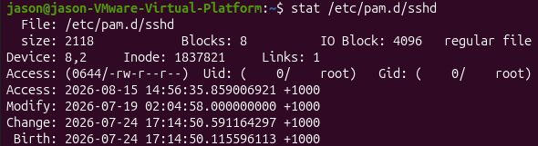
Pam DEMO (1)
Run stat initially to show that nothing has changed

Slide 9
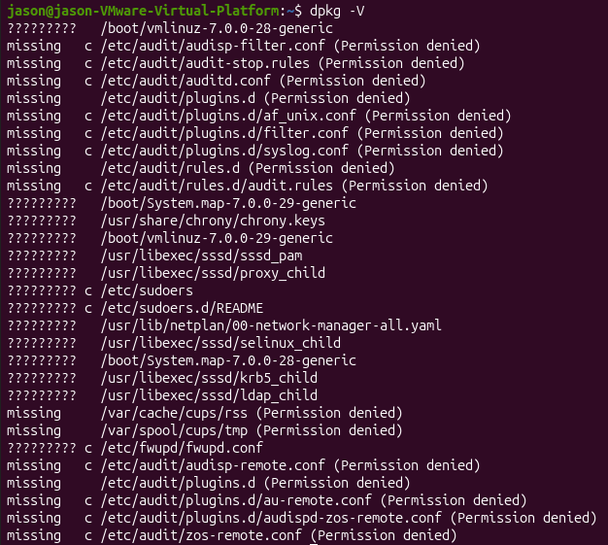
Pam DEMO (2)
Dpkg is the Debian package manager
The –V option is used to verify packages

Slide 10
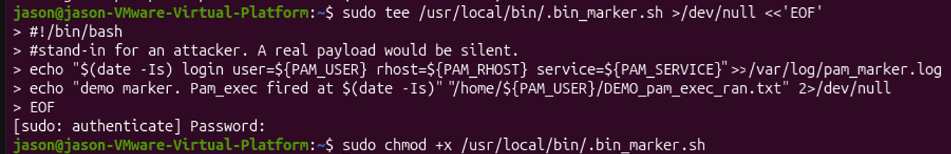
Pam DEMO (3)
The below will create a bash script that:
  Creates a log file in a /var/log
  Drops a text file in the user’s profile
Then make the script executable

Slide 11

Pam DEMO (4)
Setting up and confirming auditctl is running
Altering the SSHD configuration file

Slide 12
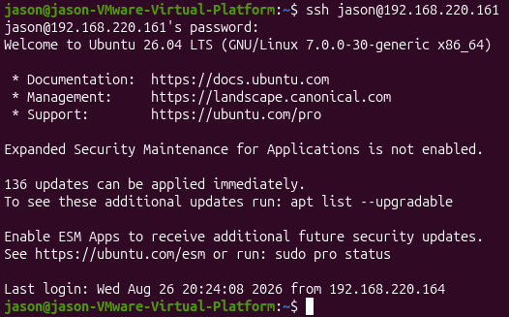
Pam DEMO (5)
The attacker system logging into the compromised endpoint post PAM tampering

Slide 13
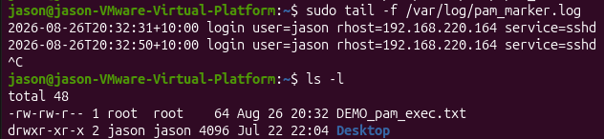
Pam DEMO (6)
Checking the marker log file created shows connections to the endpoint.
The dropped file is also shown when we drop it here.

Slide 14

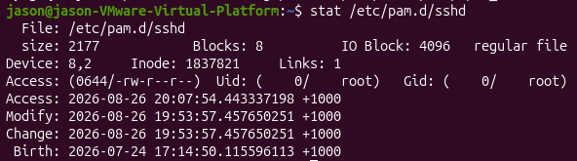
Pam Detection (1)
Detection 1 – Package Verification
  dpkg –V openssh-server
  dpkg –S /usr/local/bin/.pam_marker.sh
Detection 2 – Timestamps
  stat /etc/pam.d/sshd
Detection 3 – OS Query
  SELECT path, filename, mtime, ctime, uid, gid, size, hash.sha256 FROM file WHERE path = '/etc/pam.d’;

Slide 15
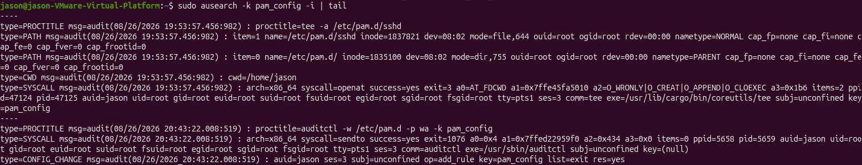
Pam Detection (2)
Detection 4 – auditd
  auditctl –w /etc/pam.d/ -p wa –k pam_config
  ausearch –k pam_config –i | tail

Slide 16
LD_PRELOAD
Notes:
The second vector has the same idea but goes after a different layer of the operating system however, this one is more unsettling because your tools are part of the attack surface.

Slide 17
Ld_preload mechanics
The chain follows:
  binary
  ld.so
  resolves shared library
  Runtime
This can be altered before the hook
  /etc/ld.so.preload
  Hook .so loads first
  Overrides symbols in libc
Persistence locations missed:
Location | Scope
/etc/ld.so.preload | Every dynamically linked binary system-wide
LD_PRELOAD env var in system unit Environment= | Per-service
Ld.so.conf.d/* additions | Every binary, via library path
/etc/environment, pam_env, .bashrc | Per-login session
Notes:
The dynamic linker, which is ld.so, is what resolves shared library symbols at runtime. Every time a dynamically linked binary calls a libc function, it goes through the linker. LD_PRELOAD is a designed feature that lets you force a library to load first, before everything else. There are legitimate uses for this such as debugging and profiling. Malicious use on the other hand includes: overriding libc functions. Your tools will typically use the functions readdir, open, and stat to see what’s on the system. A hook on those functions can make files, processes, and network connections disappear from view. The persistence that makes it system-wide is one file: /etc/ld.so.preload. This file tells the linker to preload a library into every dynamically linked process. On most systems, this file simply should not exist. Its presence is the detection.

Slide 18
Ld_preload Exploitation
What gets hooked:
  readdir()
  readdir64()
Establishing persistence:
  echo /usr/local/lib/libprocesshider.so > /etc/ld.so.preload
Notes:
The hook overrides readdir and readdir64 which is the directory-listing function that everything calls. So when you wire it into /etc/ld.so.preload it loads into every new process. This is why it is such an interesting method of exploitation, it is able to hook inside your tools. So when you call ls and point it to a directory, you’re calling the same hooked readdir function. Your find command and custom triage scripts do the same. The two things that escape are a statically linked binary which never touches the dynamic linker and memory.

Slide 19
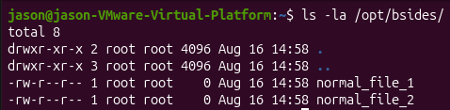
Ld_preload demo (1)
I put three files in /opt/bsides
Searching /opt/bsides with ls –la shows two files
Notes:
There are 3 file in /opt/bsides which we will look at. When we run ls –la /opt/bsides the bsides_marker file is gone.
There are only two file showing with ls –la as the hook filtered it. Everything your tools tell you about this directory is filtered through the hooked readdir function. On the other hand, if we use a tool like busybox which is a statically linked library

Slide 20
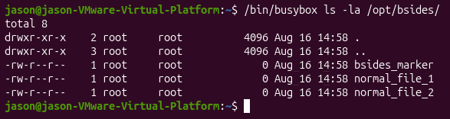
Ld_preload demo (2)
Using a statically linked binary like busybox
We can reveal our marker file
Notes:
There are 3 file in /opt/bsides which we will look at. When we run ls –la /opt/bsides the bsides_marker file is gone.
There are only two file showing with ls –la as the hook filtered it. Everything your tools tell you about this directory is filtered through the hooked readdir function. On the other hand, if we use a tool like busybox which is a statically linked library

Slide 21

Ld_preload demo (3)
Let’s check for ld.so.preload
Notes:
Let’s take a look and see the persistence behind this mechanism. Strange, if we run ls over /etc and grep the output and search for ld.so, we find that ld.so.preload does not exist
What if we run busybox over the directory? We find that this too was being hidden by the ld_preload mechanism. We can run cat over the ld preload file and this shows where the file points to

Slide 22

Ld_preload demo (4)
Let’s try run Busybox over the directory.
Let’s run cat over the file and see what happens.
Notes:
Let’s take a look and see the persistence behind this mechanism. Strange, if we run ls over /etc and grep the output and search for ld.so, we find that ld.so.preload does not exist
What if we run busybox over the directory? We find that this too was being hidden by the ld_preload mechanism. We can run cat over the ld preload file and this shows where the file points to

Slide 23
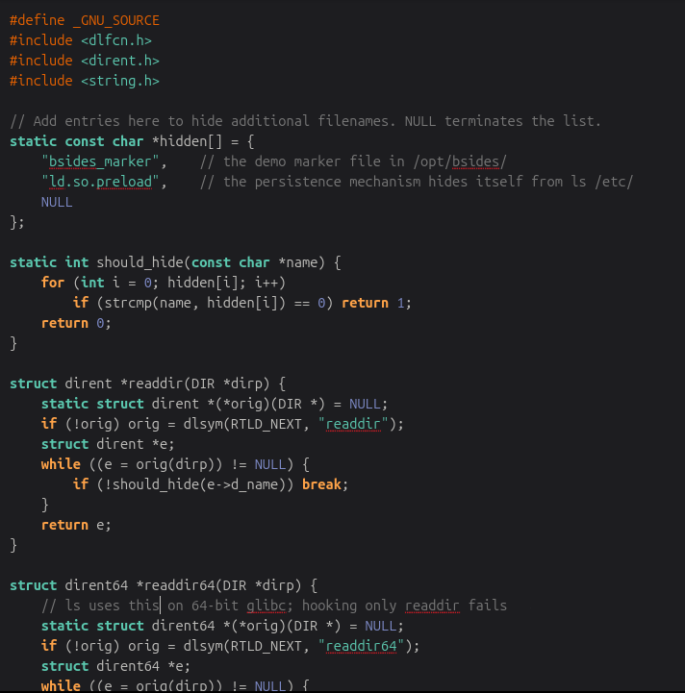
Ld_preload demo (5)
What does our hook do?
Hides files listed in the array.

Slide 24
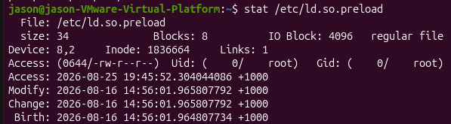
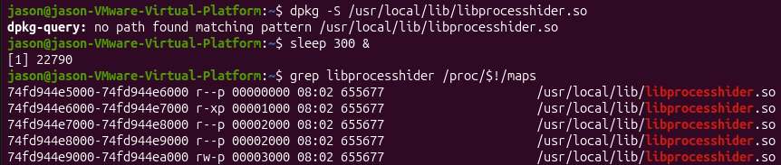
Ld_preload detection (1)
Detection 1 – Check the file itself
ls –la /etc/ld.so.preload
stat /etc/ld.so.preload
Detection 2 – The library is an orphan
dpkg –S /usr/local/lib/libprocesshider.so
sleep 300 &
grep libprocesshider /proc/<pid>/maps
Notes:
There are five detection methods we can utilise: the first is checking the folder /etc/ld.so.preload which shouldn’t exist. You should baseline this on a clean build and the presence of the file is the detection. When you look at the ctime, this tells you when the threat actor arrived
The second is detecting the hooked library is owned by no package. You can use dpkg –S on the so file and returning nothing will show that nobody owns the package. Unpackaed files in system paths are a recurring pattern across this and the PAM vector.

Slide 25
Ld_preload detection (2)
Detection 3 – Environment and memory mappings
  cat /proc/<pid>/environ | tr ‘\0’ ‘\n’ | grep LD_PRELOAD
  cat /proc/<pid>/maps | grep –v ‘\.so$’
Detection 4 - Auditd
  auditctl –w /etc/ld.so.preload –p wa –k ldpreload
  ausearch –k ldpreload –I | tail
Detection 5 – OS Query
  SELECT path, directory, filename, mtime, ctime, uid, gid, mode, size, hash.sha256 FROM file WHERE path = '/etc/ld.so.preload';
Notes:
The third method is to check /proc. The process environment and memory maps are harder to lie to than the filesystem because the hook intercepts filesystem calls, not kernel data structures. Checking live process maps for unmapped so files is a solid tactic.
The fourth method is using auditd on /etc/ld.so.preload and looking for files that have no reason for changing. Looking at the creation event catches when the file was installed.
Our fifth rule
If all else fails and you don’t trust your tools, you can do a memory capture and do analysis using volatility. Memory will show the mapping regardless of what the hooked filesystem tells you.

Slide 26
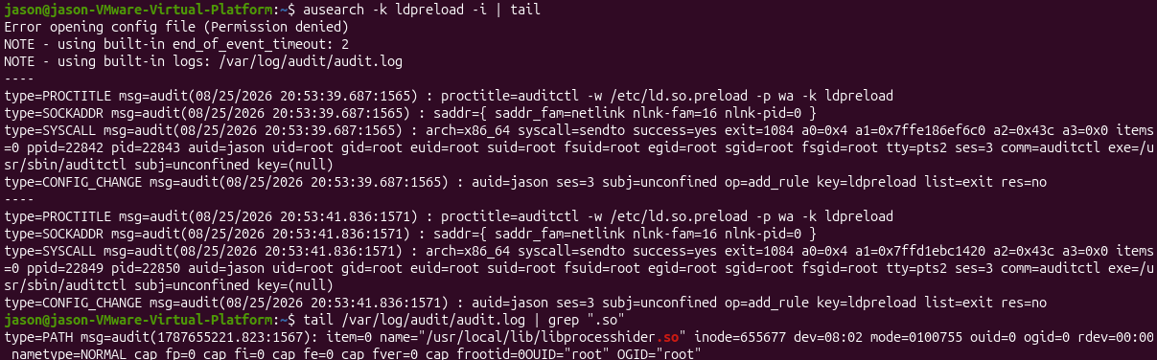
Ld_preload detection (3)

Slide 27
Takeaways (1)
Baseline and watch
  /etc/pam.d/* - anything modified here is alerted.
  /lib/x86_64-linux-gnu/security/ - PAM security module directory. Any new or modified .so files
  /etc/ld.so.preload – presence of this should alert. It should not exist.
  ld.so.conf.d/* - Unexpected library paths
Run regularly
  dpkg –V on Debian/Ubuntu / rpm –Va for RedHat
Notes:
Everything today comes back to one thing: the OS gives you ground truth, if you know where to look. Across both vectors the same small toolkit wins — package verification, file integrity on a handful of config locations, process and environment inspection, and memory when you can't trust the rest. None of it is exotic or groundbreaking. The checklist is on the slide and in the repo — take a photo, I'll be here for a minute after.

Slide 28
Takeaways (2)
Deploy auditd to watch the above paths
Trust static binaries and /proc over hooked userland tools
When two views are different, the dynamic one is lying
Unpackaged files are a telltale sign
Notes:
Everything today comes back to one thing: the OS gives you ground truth, if you know where to look. Across both vectors the same small toolkit wins — package verification, file integrity on a handful of config locations, process and environment inspection, and memory when you can't trust the rest. None of it is exotic or groundbreaking. That's exactly why it's missed. The checklist is on the slide and in the repo — take a photo, I'll be here for a minute after.

Slide 29
Resources + contact
Contact: https://www.linkedin.com/in/jason--trapp/
GitHub: https://github.com/jasontrapp
  Auditd rules
  hook.c
  pam_marker.sh
  Triage one-liners
https://attack.mitre.org/techniques/T1556/003/ - PAM
https://attack.mitre.org/techniques/T1574/006/ - Dynamic Linker Hijacking
Notes:
You’ll find the slides as well as auditd rules, demo scripts, and the triage one-liners are all in there. If you want to get in contact with me, connect with me on LinkedIn. Happy to take on any questions.

